Slide 1
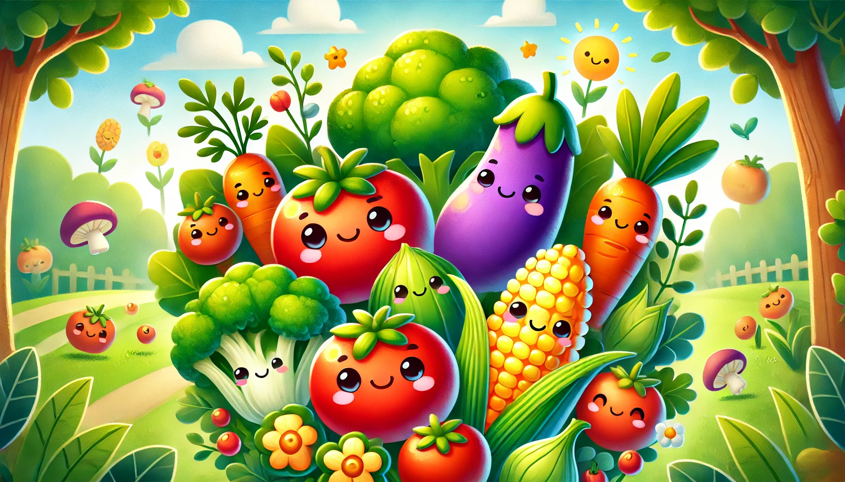
Healthy Artists
Coloring Book

Slide 2


Trace & Color
Vegetables
Cabbage

Slide 3

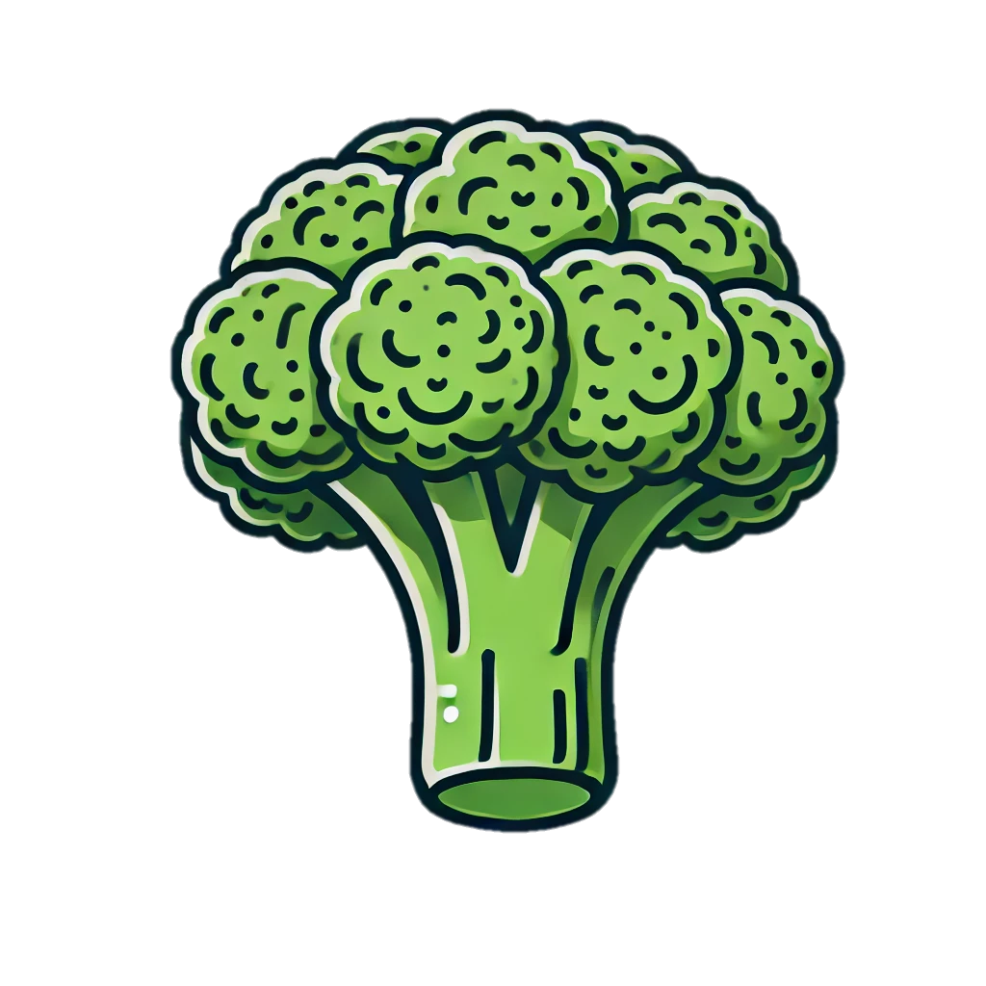
Trace & Color
Vegetables
Broccoli

Slide 4


Trace & Color
Vegetables
Lettuce

Slide 5


Trace & Color
Vegetables
Cauliflower

Slide 6


Trace & Color
Vegetables
Mushroom

Slide 7
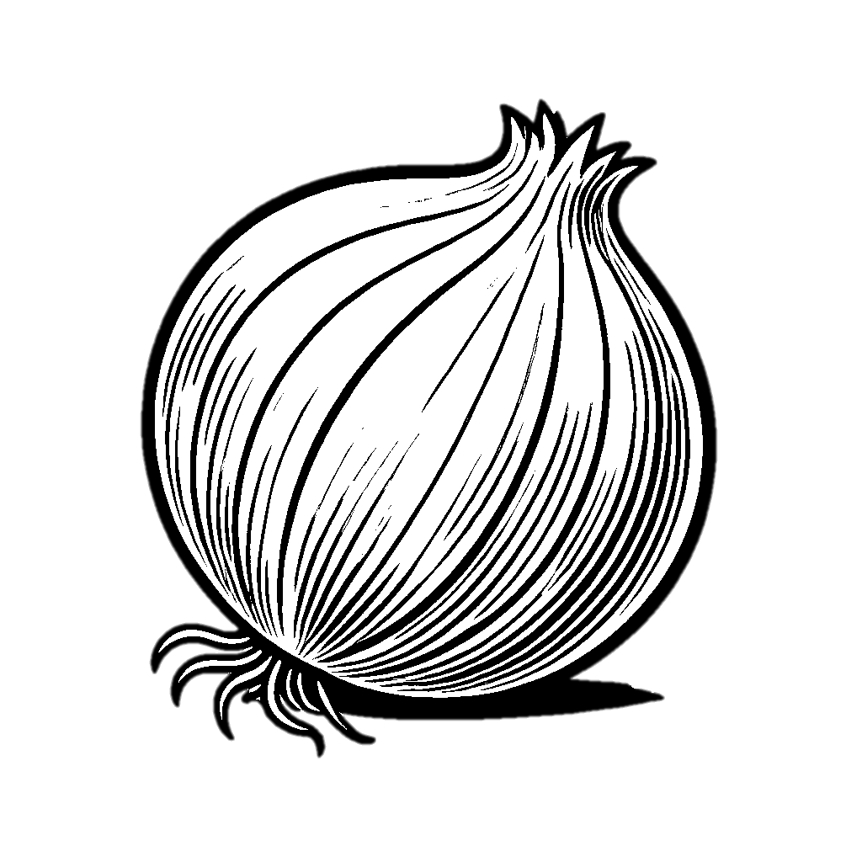

Trace & Color
Onion
Vegetables

Slide 8
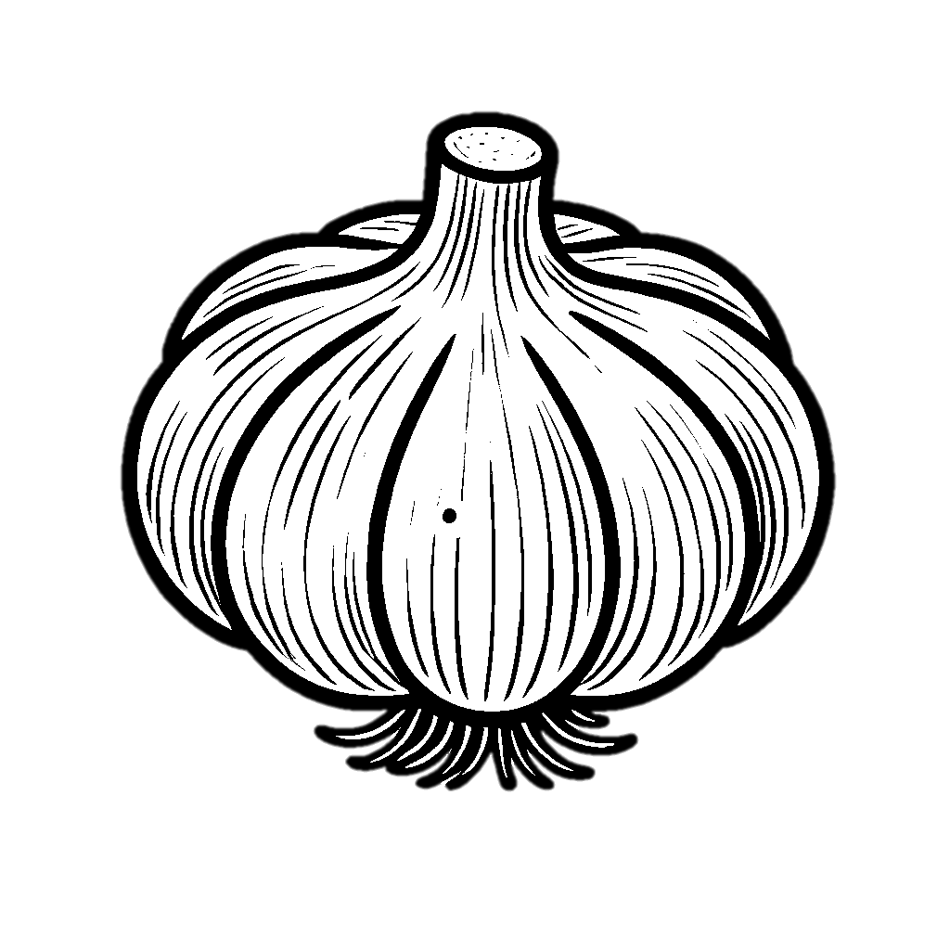
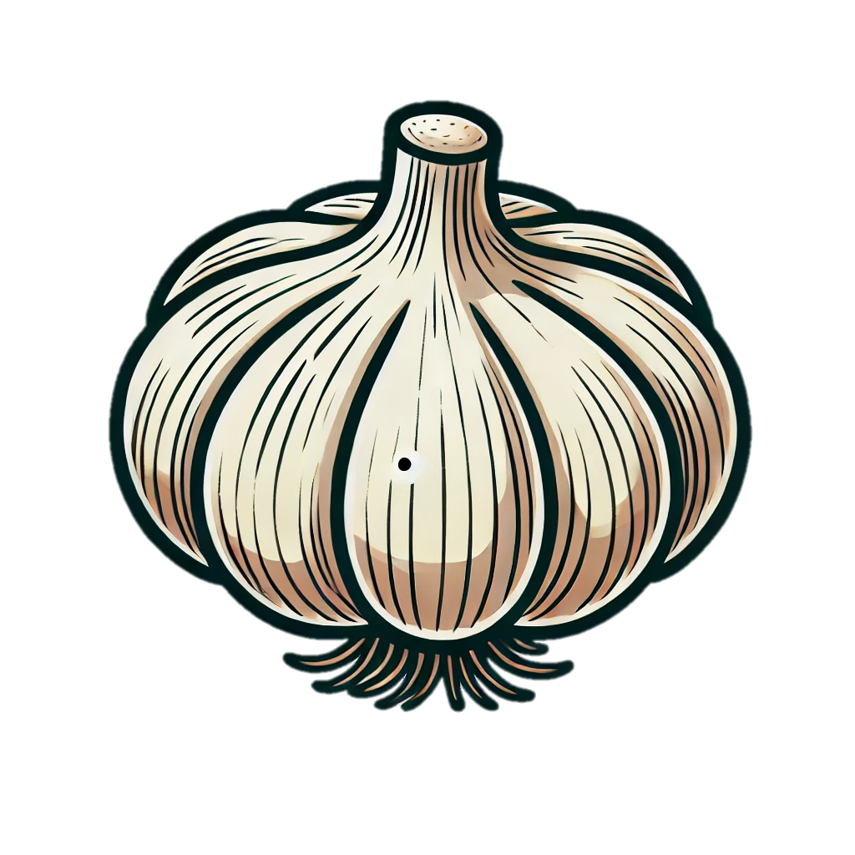
Trace & Color
Garlic
Vegetables

Slide 9


Trace & Color
Capsicum
Vegetables

Slide 10


Trace & Color
Vegetables
Hot Pepper

Slide 11


Trace & Color
Vegetables
Eggplant

Slide 12


Trace & Color
Vegetables
Potato

Slide 13


Trace & Color
Vegetables
Tomato

Slide 14
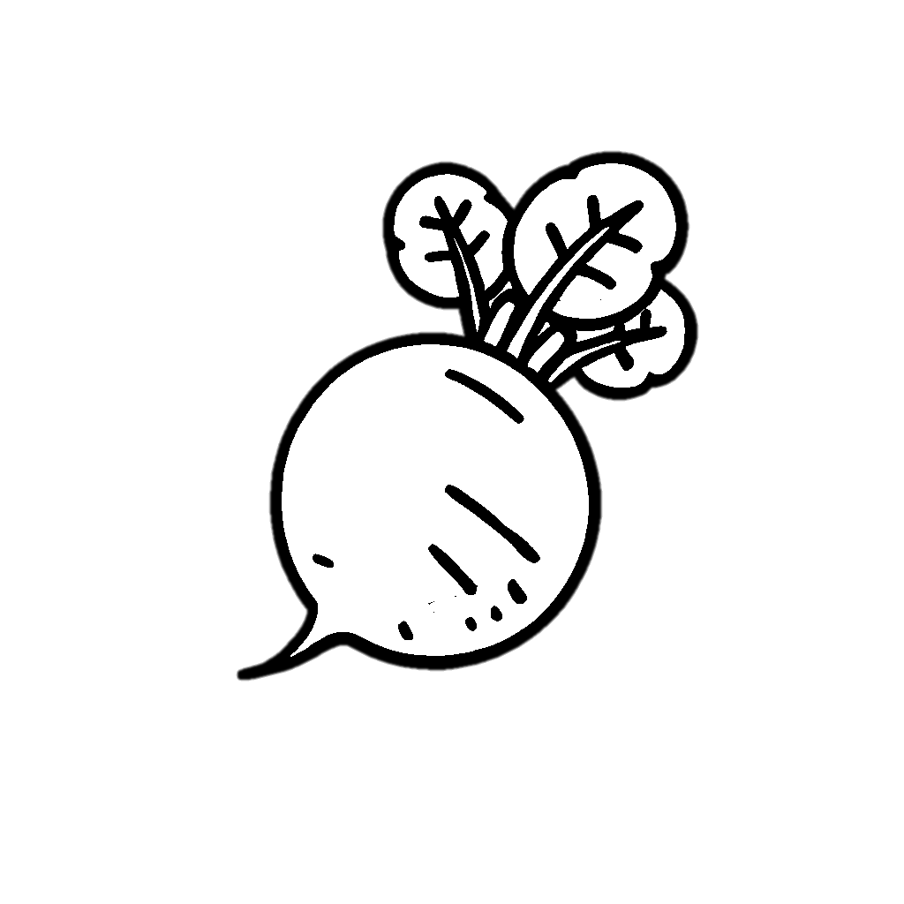

Trace & Color
Vegetables
Radish

Slide 15


Trace & Color
Vegetables
Carrot

Slide 16


Trace & Color
Vegetables
Beetroot

Slide 17

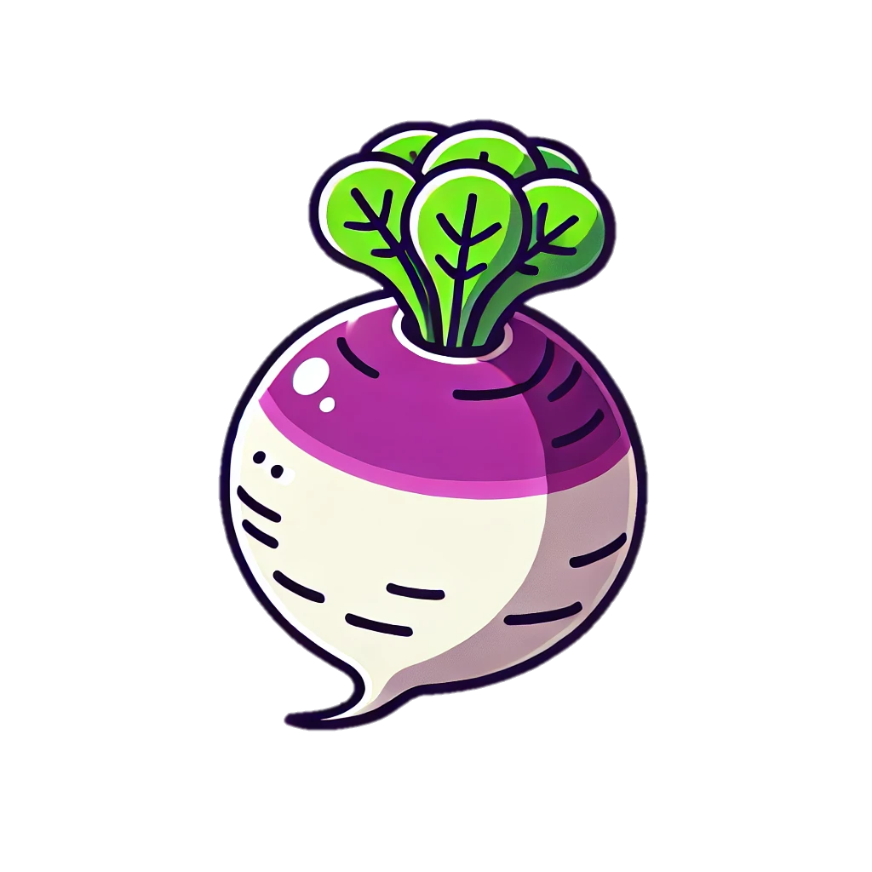
Trace & Color
Vegetables
Turnip

Slide 18


Trace & Color
Vegetables
Pumpkin

Slide 19


Trace & Color
Vegetables
Spinach

Slide 20

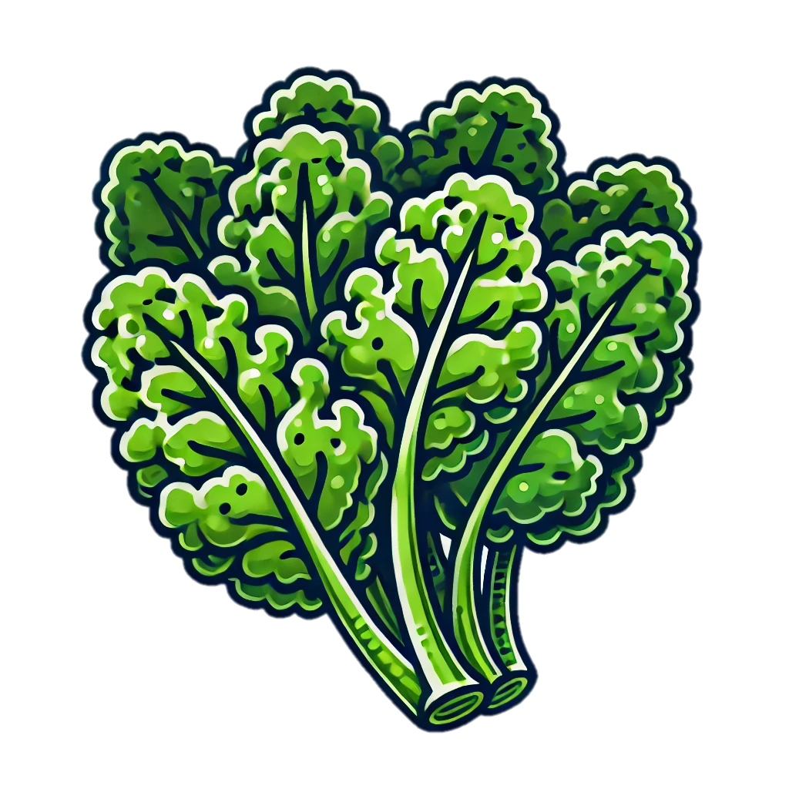
Trace & Color
Vegetables
Kale

Slide 21


Trace & Color
Vegetables
Artichoke

Slide 22


Trace & Color
Vegetables
Okra

Slide 23


Trace & Color
Vegetables
Zucchini

Slide 24


Trace & Color
Vegetables
Cucumber

